Slide 1
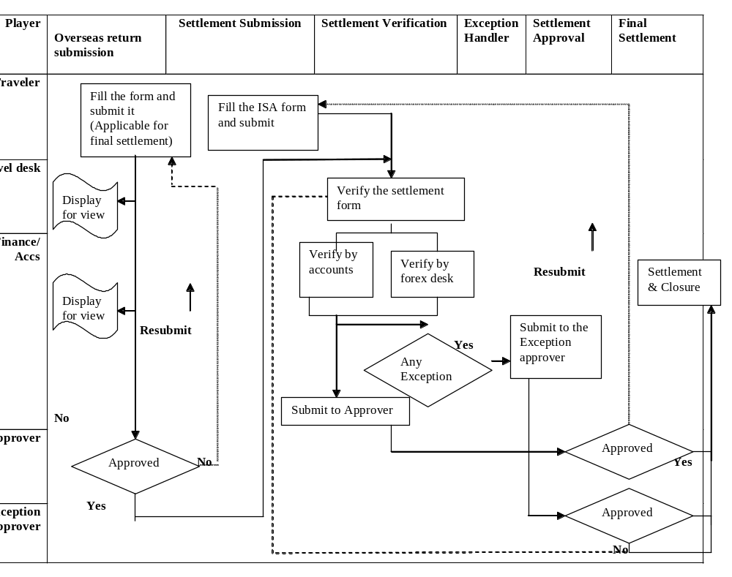
Overseas Settlement Flow

Slide 2
How do I do my Overseas Settlement ?
The ORF – Overseas Return Form
The OSF – Overseas Settlement Form

Slide 3
ORF- Overseas Return Form
Once the employee returns from the overseas trip , he/she needs to inform about the return to the travel desk ,forex desk and the attendance.
The ORF can be submitted in Payana against your overseas travel request.

Slide 4
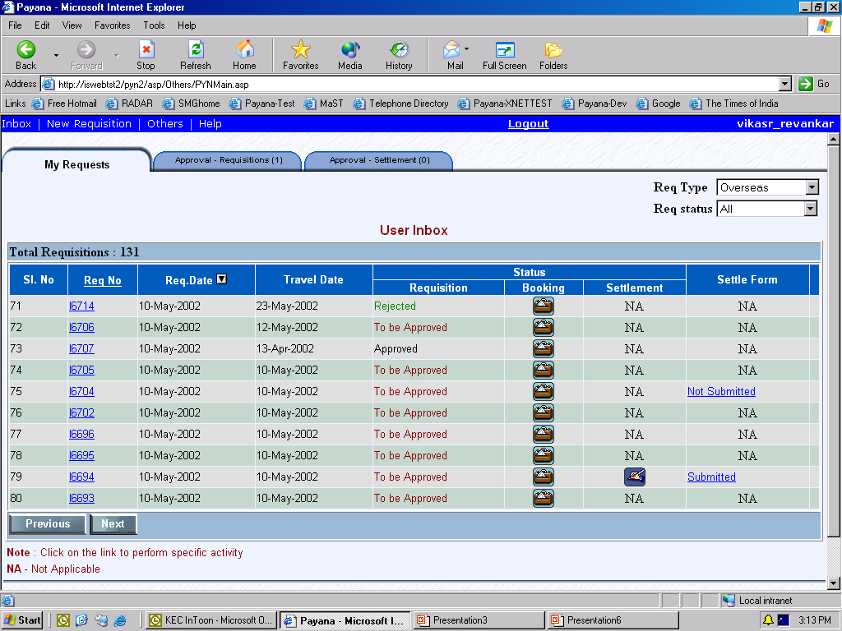
The settlement form needs to be submitted – click on “Not submitted”

Slide 5
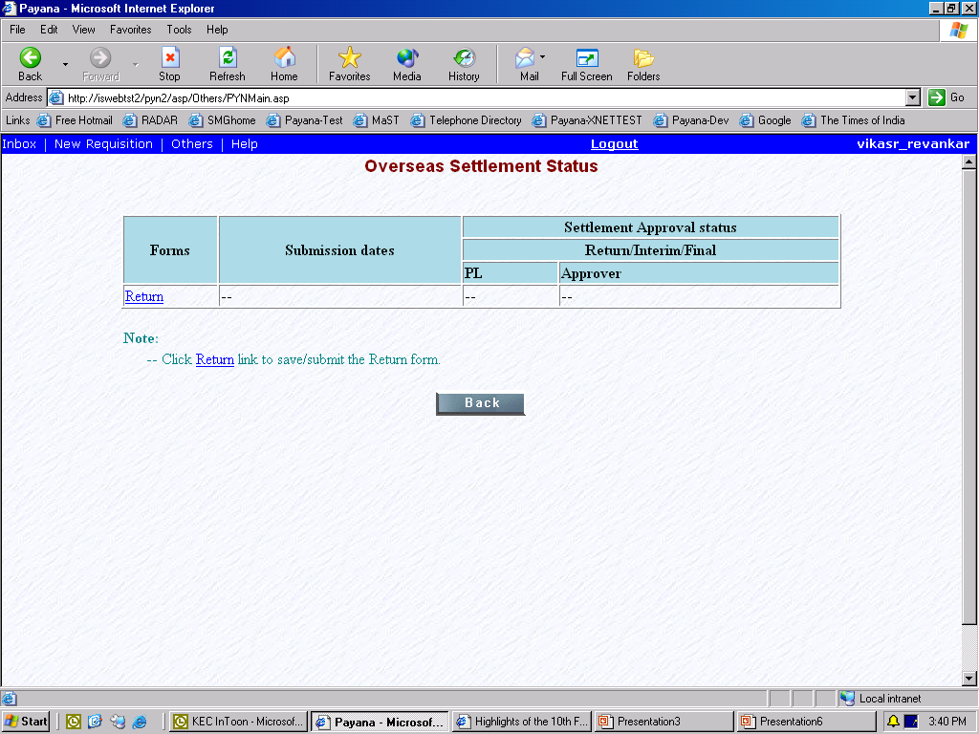
Click on RETURN to submit the ORF

Slide 6
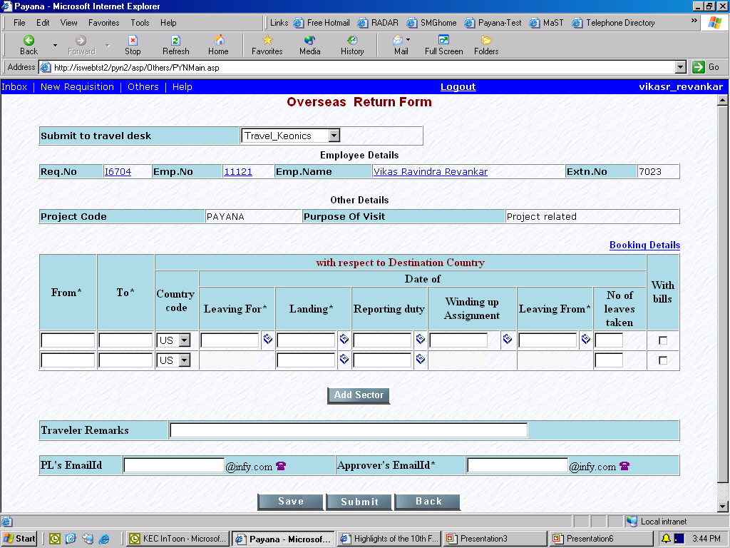
Specify your actual travel details and submit this ORF.

Slide 7
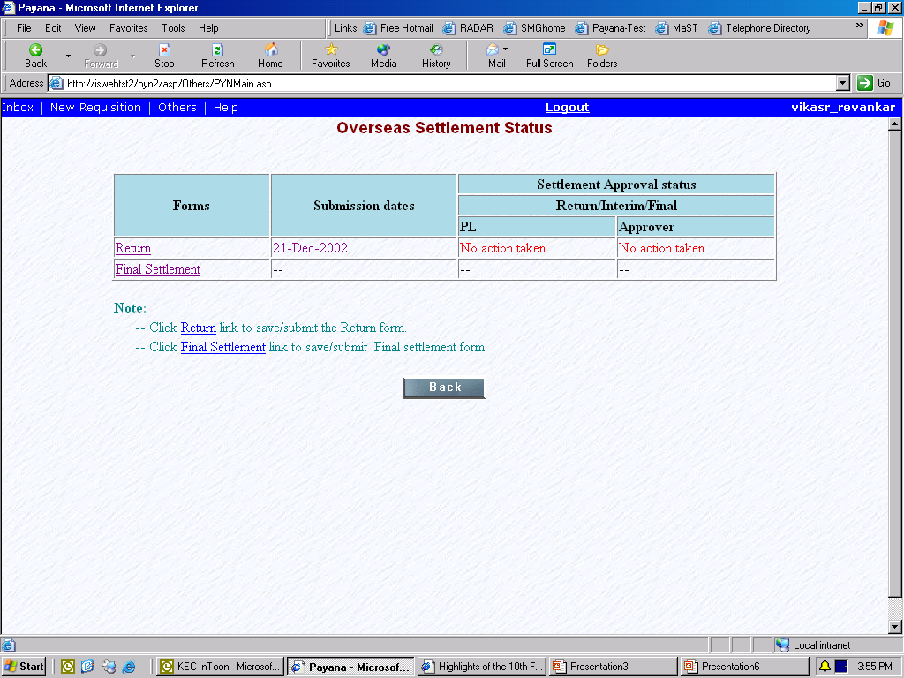
You can submit the settlement form (claims/bills) at the same time.

Slide 8
You can submit the OSF along with the ORF.
The ORF will be visible as read only to the TRAVEL DESK, ACCOUNTS DESK & FOREX DESK.
The OSF will be available to the travel desk only after your approver approves the ORF.
Once the ORF gets approved, if you have submitted your OSF – it will be visible to the travel desk for verification.

Slide 9
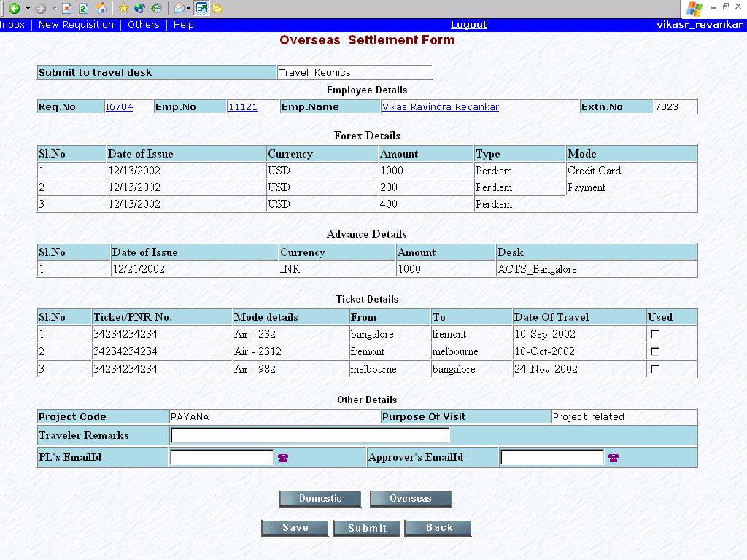
Specify if you have used the tickets issued to you.

Slide 10
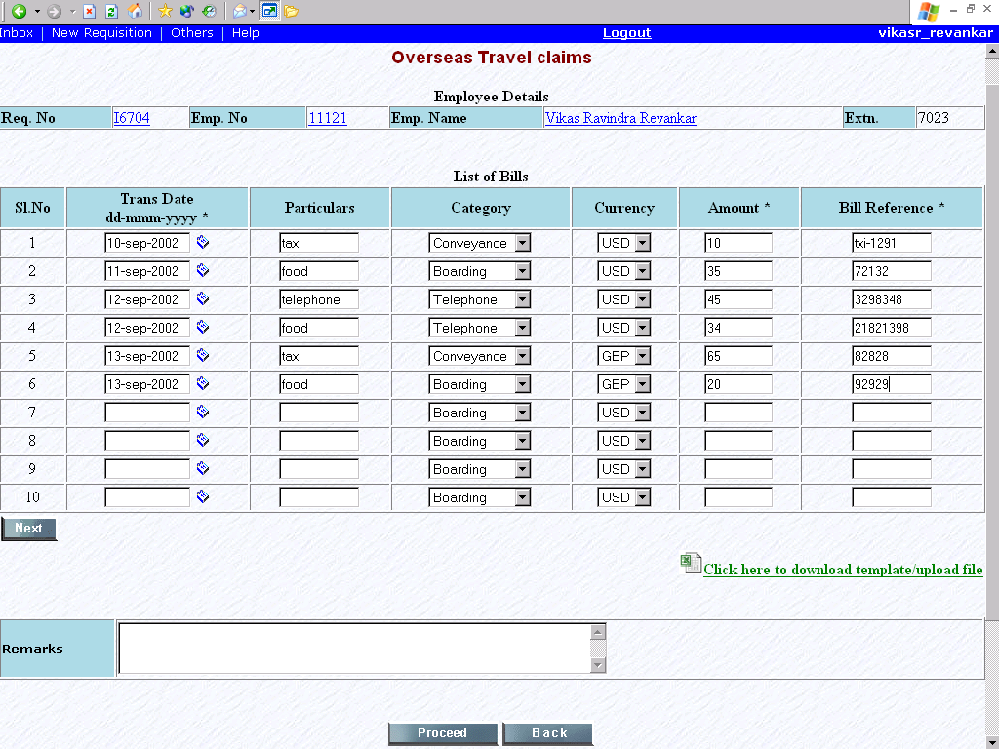
Press “NEXT” to enter more than 10 bills
Specify your bills over here .
Press “PROCEED” to go to the next screen

Slide 11
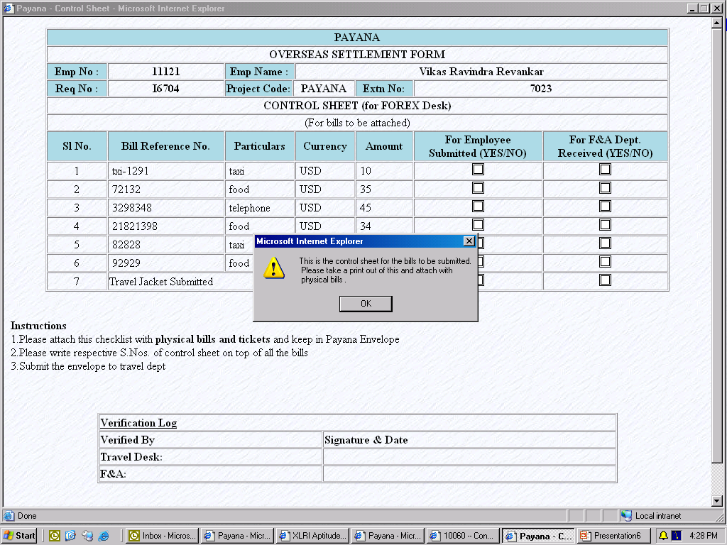
Take a print of this control sheet and attach with the PAYANA ENVELOPE in which you shall submit your bills

Slide 12
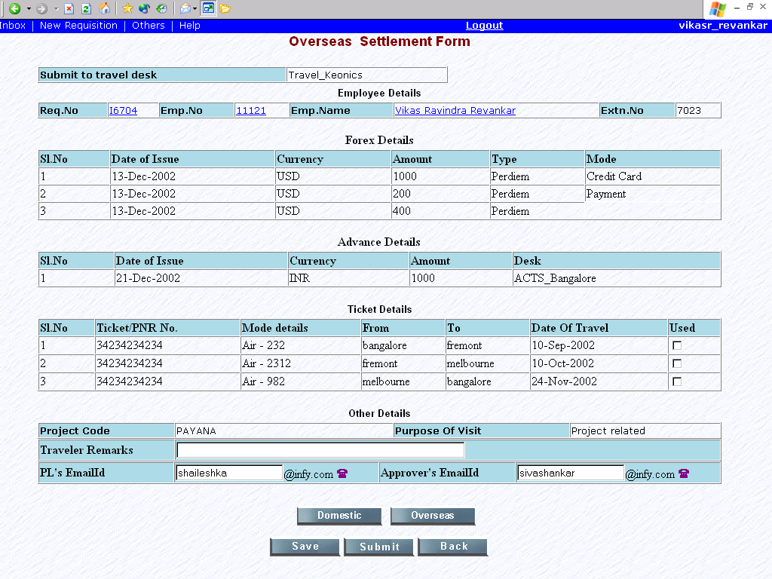
Once you have filled the bill details submit it to your approver . The rest of the flow is explained in the next slide.

